Slide 1
COMP 2710 Software Construction
Use Case Analysis
Dr. Alvin Lim
Auburn University
http://www.eng.auburn.edu/~lim
limalvi@auburn.edu
Fall 2014
Adapted from Lectures from Dr. Xiao Qin
1-<number>

Slide 2
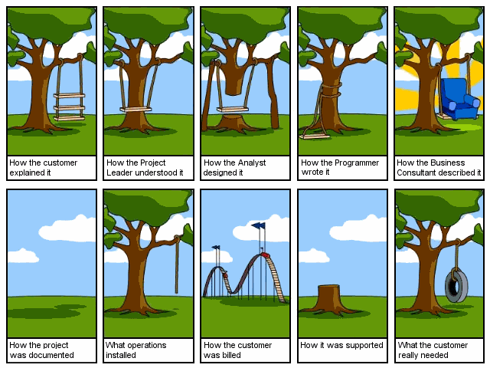
Source: http://www.hariscusto.com/funny/software-engineering-explained/
1-<number>

Slide 3
Motivations – Why use cases?
Offer a disciplined way to develop a system and deal with its complexity.
They are great test cases for the system.
They provide quantifiable progress.
They provide a strong base for formulation of other models.
1-<number>

Slide 4
Goals of Use Case Analysis
Look at the system as a whole
Express software requirements
Identify all the major uses of the system
Express computer application workflow
It is a functional description of the entire system.
Note: use cases are not design tools. Just functional descriptions not software structure.
1-<number>
Notes:
· Use Cases are the main tasks performed by the users of the system.
· Use Cases describe the behavioral aspects of the system.
· Use Cases are used to identify how the system will be used.
· Use Cases are a convenient way to document the functions that the system must
support.
· Use Cases are used to identify the components (classes) of the system.
But use cases are not design tools. They do not specify the structure of the eventual
software, nor do they imply the existence of any classes or objects. They are purely functional descriptions
written in a formalism that is completely separate from software design.

Slide 5
Formal Definition - Actor
A role that a user can play.
Examples: instructor, advisor, student.
Actors do not have to be human. An actor such as a sensor may cause a system reaction.
An actor is always outside of the system boundary, an external entity.
1-<number>

Slide 6
Formal Definition - Use Cases
Actions on a system initiated by an actor. These are the main tasks performed by each actor. Use cases represent complete functionality of a task.
Example: Register for course.
1-<number>
Notes:
Give an example: www.dropbox.com Log in as a use case

Slide 7
Formal Definition - User
Someone who uses the system.
The same user can play multiple roles.
Example Prof. John Doe plays the role of an instructor and the role of an advisor.
A user is an instance of an actor.
Can you give an example in which one user can play multiple roles?
1-<number>
Notes:
Can you give an example in which one user can play multiple roles?
Paper review systems

Slide 8
Formal Definition - Views
Two or more actors may interact with a use case.
Example Register for Course involves both the Student registering for the course and the Bursar's office sending out a bill for it. Each actor views this task from a different perspective.
1-<number>

Slide 9
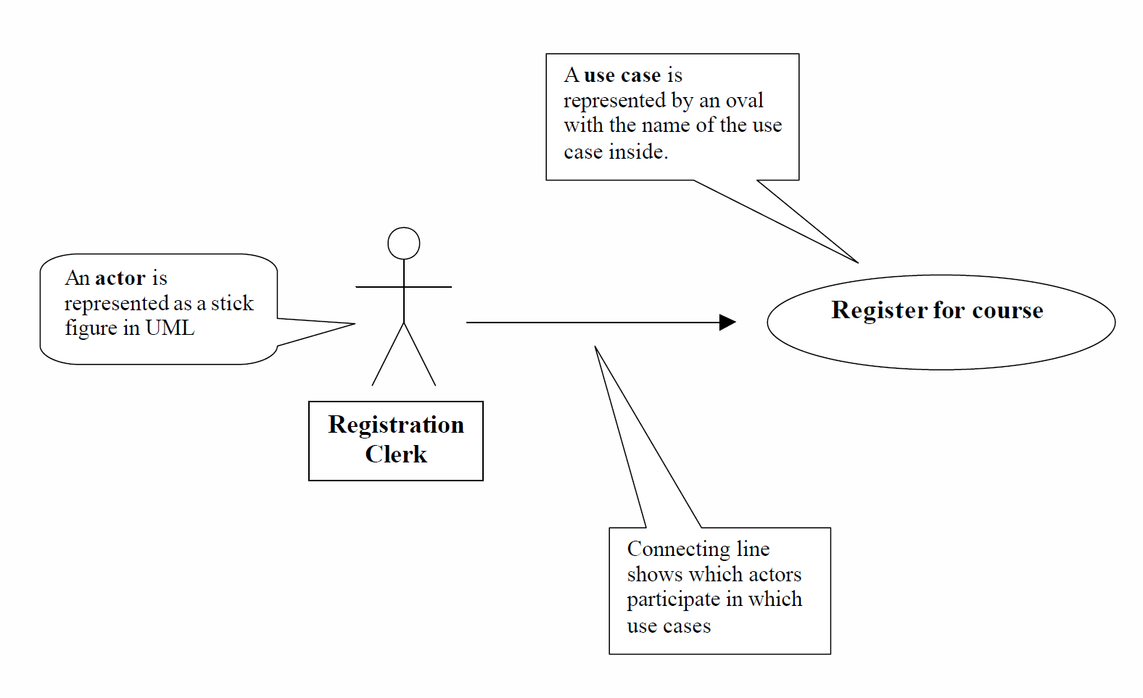

UML Symbols
There could be different sequences of individual steps for the same use case. These are called scenarios.
1-<number>
Notes:
A use case is only a high-level description of an activity that will be performed on a
system. It may require a sequence of individual steps to carry out the use case.
There could be different sequences of individual steps for the same use case. These are
called scenarios. For example, use case register for classes may have two scenarios, one
for registering through an advisor and one for online registration.

Slide 10
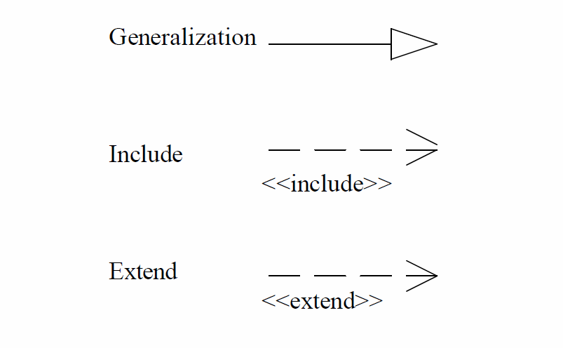
Use Case Diagrams
UML use case relationship -symbols
Relationships: Use cases may be related to other use cases.
1-<number>

Slide 11
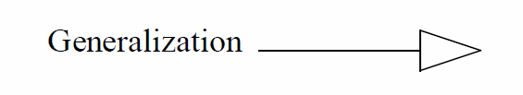
UML use case relationship symbols - Generalization
A use case that is a variation on normal behavior of another use case describes a generalization relationship.
These generalization use case relationships can be used to describe actions when an alternative behavior must be carried out for some reason.
1-<number>

Slide 12
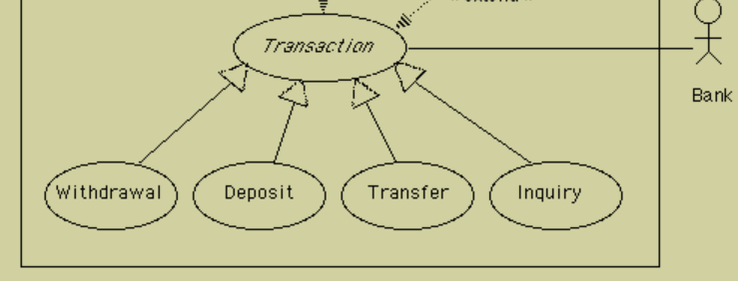
UML use case relationship
Generalization - Example
1-<number>

Slide 13
UML use case relationship
Generalization – Exercise
Log in to www.dropbox.com
  Successfully log in
  Unable to successfully log in
1-<number>
Notes:
reviewer ------- (log in) <- (log in - successful)
^
|
(log in - fail)

Slide 14
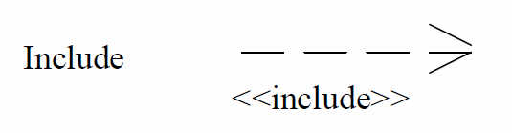
UML use case relationship symbols – include or use
A use case may include another use case.
A use case that is included is generally a common behavior that many use cases may need.
One use case will use the services of another use case.
1-<number>
Notes:
<<includes>>, <<include>>, <<use>>, <<uses>>

Slide 15
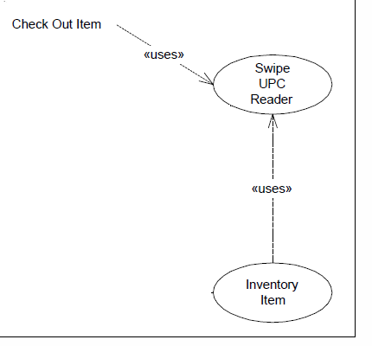
UML use case relationship include or use - Example
1-<number>

Slide 16
UML use case relationship include or use – Exercise
Review Transcript Data use case is used by the Register for Course use case to be sure the student has met the course's prerequisites.
Review Transcript Data use case is also used by Graduate Student use case to be sure that all program requirements have been met for graduation.
1-<number>
Notes:
(review transcript data) <------- <<include>>----- -- (register for course) --------------- students
^
|
<<include>>
|
reviewer -------(graduate student)

Slide 17
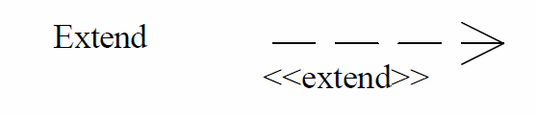
UML use case relationship symbols – extend or extends
A use case may extend a use case by adding new actions to it.
1-<number>
Notes:
<<includes>>, <<include>>, <<use>>, <<uses>>

Slide 18
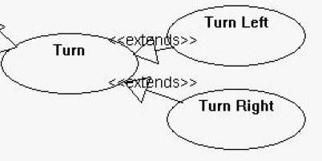
UML use case relationship extend or extends - Example
1-<number>
Notes:
Question? How about Turn – include -->turn left
|
include
|
V
turn right

Slide 19
UML use case relationship extend or extends – Exercise
Use case Register for Distance Course may extend use case Register for Course.
Additional actions must be performed when a student registers for a distance course.
1-<number>
Notes:
reviewer ------- (register for course) <-- extend -- (register for distance course)

Slide 20
What is the difference between uses/includes and extends?
1-<number>
Notes:
Question? How about Turn – include -->turn left
|
include
|
V
turn right

Slide 21
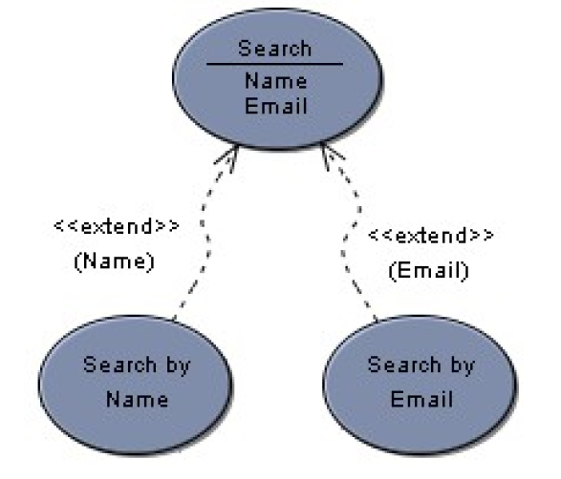
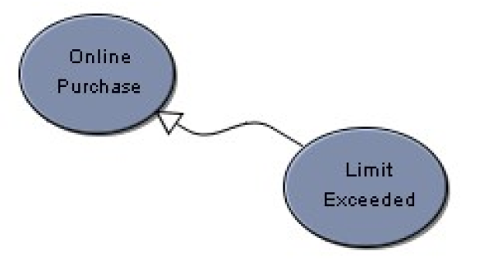
Generalization vs. Extend
A use case generalization shows that one use case is simply a special type of another.
An extend relationship indicates that one use case is a variation of another.
Adding actions.
1-<number>
Notes:
References: Visual Case - UML Tutorial – Use Case Diagram.pdf
Generalization: (not very popular) When a use case describes a variation on another use case, use a generalization link. In the example below, the use case limit exceeded describes a situation in which the usual scenario of online purchase is not performed. Use cases that generalize another use case should only specify an alternative, even exceptional, scenario to the use case being generalized. The overall goal of the use cases should be the same. (Same Goal)
Extend: In some instances you want to describe a variation on behaviour in a more controlled form. In such instances you can define extension points in the extended use case. In the example below, search by name is said to extend search at the name extension point. The extends link is more controlled than the generalization link in that functionality can only be added at the extension points. (different Goal)

Slide 22
Development of a Use Case Diagram
Identify all of the actors who will use the system.
Interview these actors to identify the functions that they need to perform. (use cases)
Identify scenarios (sequence of steps to accomplish a use case).
Identify common steps within the different scenarios. Separate them into different use cases so that they can easily be included in other scenarios.
Identify relationships between use cases.
1-<number>
Notes:
Give an example: www.dropbox.com Log in as a use case

Slide 23

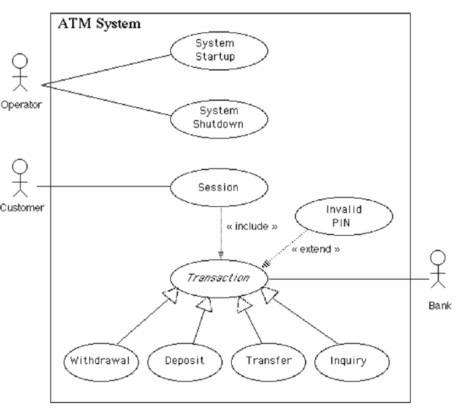
Put it all together:
1-<number>

Slide 24
Flows of Events for Individual Use Cases
- System Startup Use Case
The system is started up when the operator turns the operator switch to the "on" position.
The operator will be asked to enter the amount of money currently in the cash dispenser
A connection to the bank will be established.
Then the servicing of customers can begin.
1-<number>
Notes:
Give an example: www.dropbox.com Log in as a use case

Slide 25
Flows of Events for Individual Use Cases
Exercise - System shutdown Use Case
The system is shut down when the operator makes sure that no customer is using the machine, and then
turns the operator switch to the "off" position. The connection to the bank will be shut down. Then the
operator is free to remove deposited envelopes, replenish cash and paper, etc.
1-<number>

Slide 26
Use Case Diagram - Exercise
Actors:
  customer,
  waiter,
  chef,
  cashier
Use Cases:
  order food, cook food, serve food, eat food,
  order wine, serve wine, drink wine,
  pay for food, pay for wine
Use case relationships?
1-<number>

Slide 27
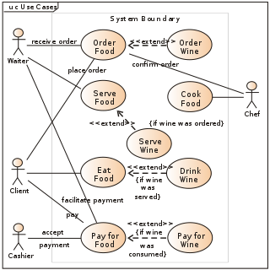
Use Case Diagram – Exercise
1-<number>
Notes:
References: Visual Case - UML Tutorial – Use Case Diagram.pdf
Generalization: When a use case describes a variation on another use case, use a generalization link. In the example below, the use case limit exceeded describes a situation in which the usual scenario of online purchase is not performed. Use cases that generalize another use case should only specify an alternative, even exceptional, scenario to the use case being generalized. The overall goal of the use cases should be the same.
Extend: In some instances you want to describe a variation on behaviour in a more controlled form. In such instances you can define extension points in the extended use case. In the example below, search by name is said to extend search at thename extension point. The extends link is more controlled than the generalization link in that functionality can only be added at the extension points.

Slide 28
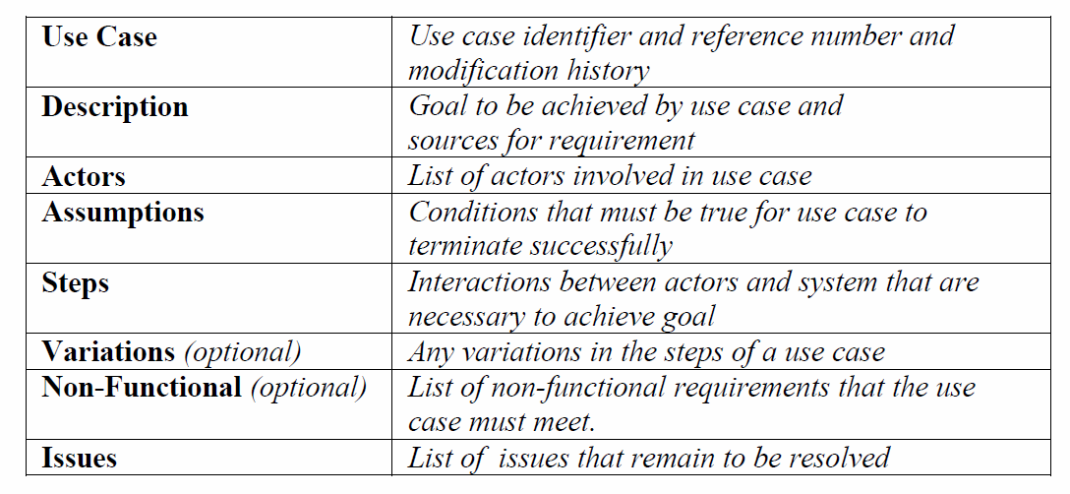
Use Case Template
Reference: http://www.bredemeyer.com/pdf_files/use_case.pdf
1-<number>
Notes:
See also: A Use Case Template.pdf

Slide 29
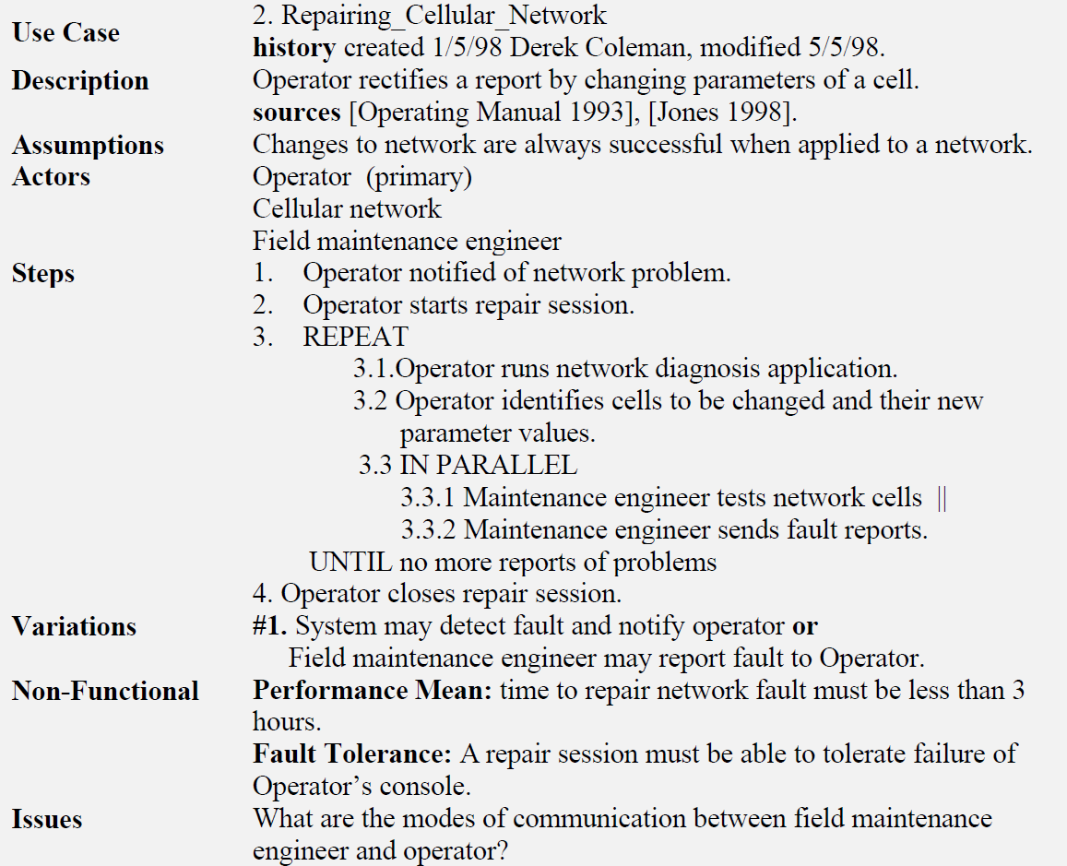
Use Case – An Example
1-<number>
Notes:
See also: A Use Case Template.pdf
The example below shows a use case that describes the interactions involved in repairing a cellular
network. The business goal of the (primary) actor the Operator is to repair the network. The other active
participants are the cellular network itself and a field maintenance engineer. The source information for the
use case comes from two sources viz. Operating Manual [1993] and [Jones 1998]. In order for the use case
to succeed it is assumed that any changes that are sent to the cellular network will not fail. That is the
network cells will change as directed.

Slide 30
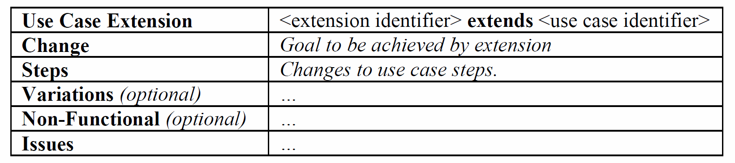
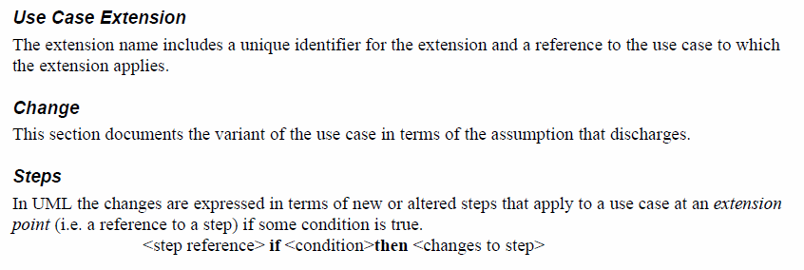
Extending a Use Case
Reference: http://www.bredemeyer.com/pdf_files/use_case.pdf
1-<number>
Notes:
See also: A Use Case Template.pdf

Slide 31
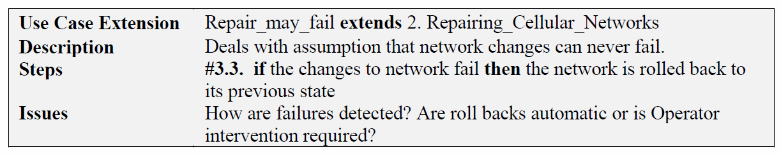
Extending a Use Case – An example
1-<number>
Notes:
See also: A Use Case Template.pdf

Slide 32
Summary
Use Cases describe the behavioral aspects of the system.
Use cases are not design tools.
Use Cases are a convenient way to document the functions that the system must support.
Use Cases are used to identify the components (classes) of the system.
Use case relationships?
1-<number>
Notes:
Why use cases are not design tools? - Just functional descriptions not software structure.

